Slide 1

Book Recommendation System
Presented by Team 5

Slide 2

Team Members
Shivam Khudsange
Rashmi Rani Biswal
Bindu S R
Anchal Mehta
Mentor & Guided by
Neha Gupta
Hareesh K C

Slide 3
Objective
The Book Recommendation System aims to provide the best suggestion to the user by analysing the buyer’s interest.
The objective is to extract the features from given data set and use them to make a Book recommender system to recommend relevant books to users.
Summary of Data
The whole dataset is divided into 3 csv files comprising of books, users and ratings data separately.
Dataset | Rows | Columns
Books | 271360 | 5
User | 278858 | 3
Ratings | 1149780 | 3

Slide 4
Project Workflow
Data Collection
Import the Data
Data Pre-processing – Cleaning, Imputation & Treating missing values, outliers.
Exploratory Data Analysis (EDA)
Merging the datasets
Built Popularity Based Model – Top Rated Books
Built Collaborative Based Model – Item & User based filtering
Model Evaluation
Challenges
Conclusion
Model Deployment using Streamlit API
Future Scope

Slide 5
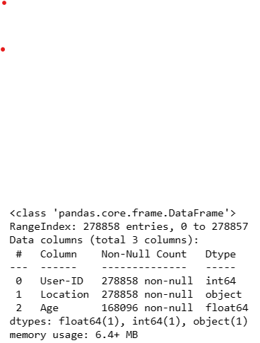
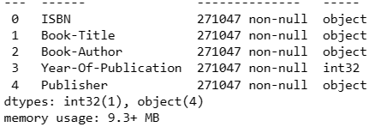
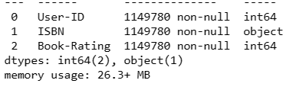
Data Overview
Users dataset
Books dataset
Ratings dataset

Slide 6
ANALYZING ALL THREE DATASET
There are almost no duplicate value’s in all 3 dataset’s.
But we have negligible null values in books dataset for some columns. We will try to impute values.
We have almost 40% null values in ratings datasets for age column.
DATA CLEANING
We have successfully replaced the incorrect value with correct values for specific columns.
We have noticed, there was some values in year of publication columns which is 0 & future years.
We have discovered, there were some values in specific columns which is swapped & does not belong to a specific column, and treated it.

Slide 7
IMPUTING DATA
In users dataset, for Nan values, we will impute with median as its neutral in presence of outlier & also the median for country close to the age of 32 years.
In Books dataset, after replacing the extreme outlier values with mode year (2002) the distribution seems to be fairly symmetrical.
As we can see, there are no null values nor any duplicate or missing values to be imputed in ratings dataset.

Slide 8
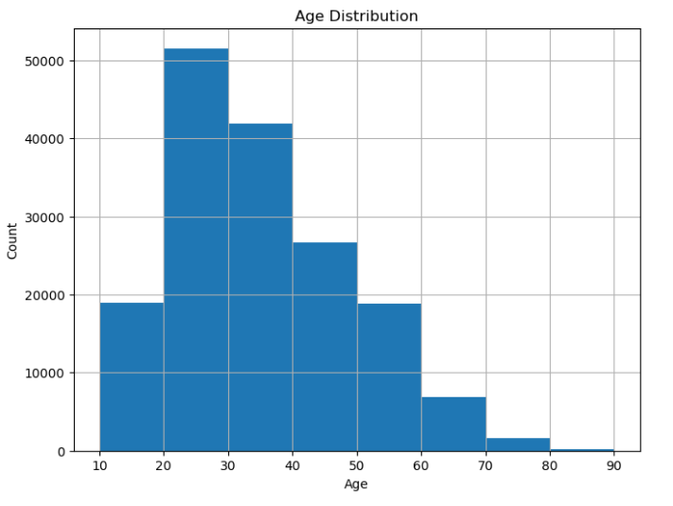
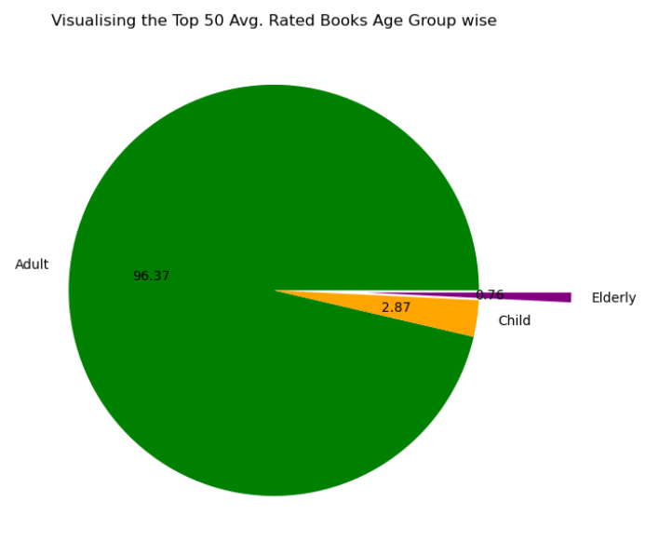
VISUALISING USERS DATA

Slide 9
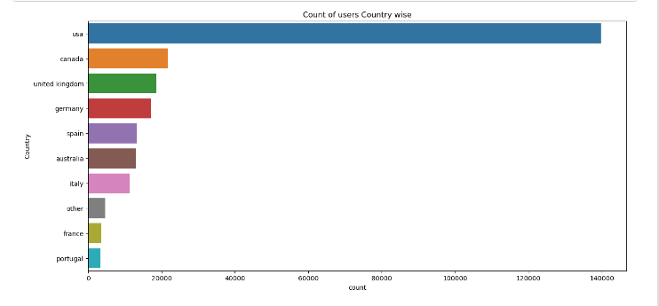
VISUALISING USERS DATA

Slide 10
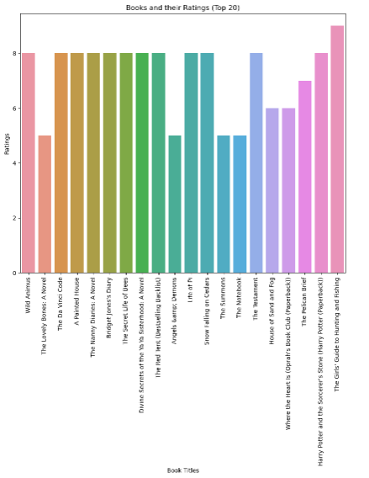
VISUALISING BOOKS DATA

Slide 11
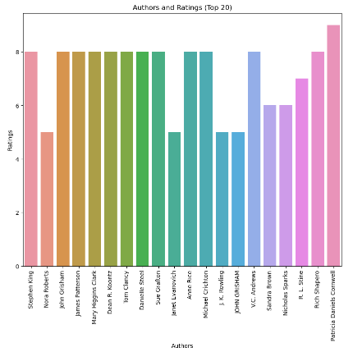
VISUALISING BOOKS DATA

Slide 12
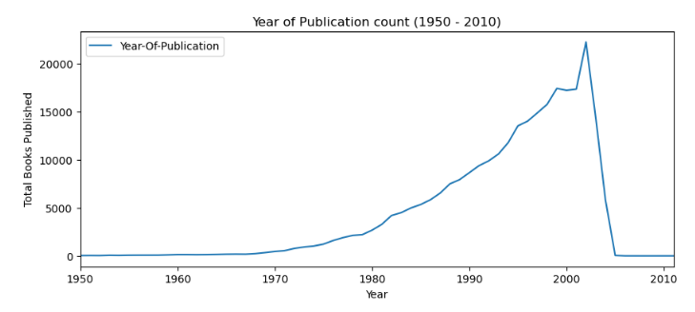
VISUALISING BOOKS DATA

Slide 13
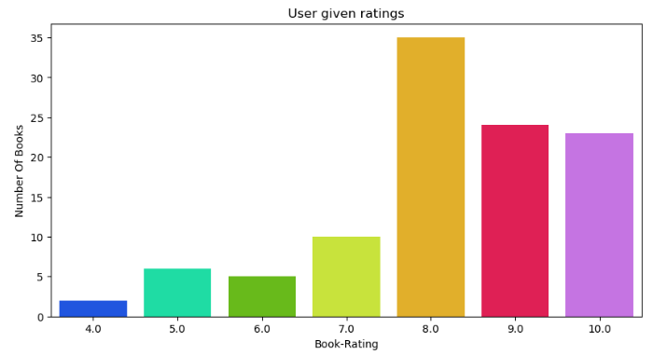
VISUALISING RATINGS DATA

Slide 14
INSIGHTS FROM EDA
The Girl’s Guide to hunting and fishing and Harry Potter and the Sorcerer’s Stone are the most rated Book of all time. Patricia Daniels Cornwell is the is the top rated author.
More than 50% readers have either not read nor rated the books which appears to be 0 in ratings. Top ratings given by maximum users are 8.
We built a popularity models based on highest average ratings for recommending books.
And we also built Item-Item Based Collaborative Filtering model using the method pair-wise.

Slide 15
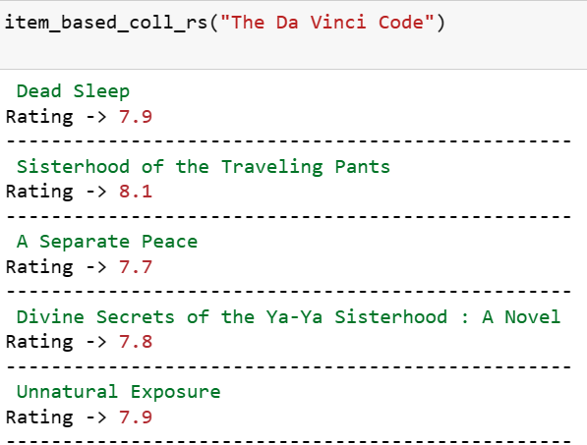
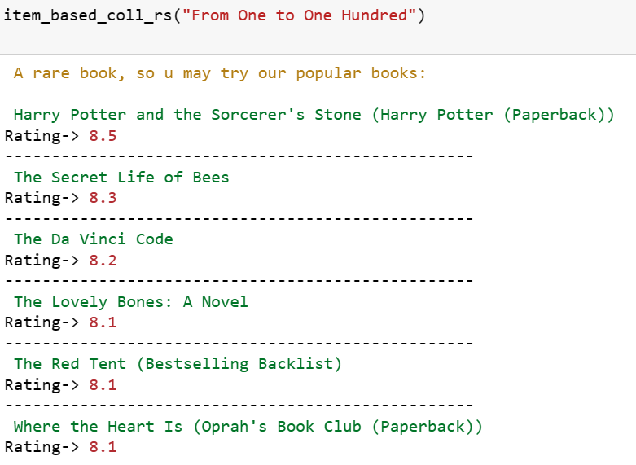
MODEL BUILDING
Pair-wise method.
Enter the book title and getting output as recommended books with ratings.

Slide 16
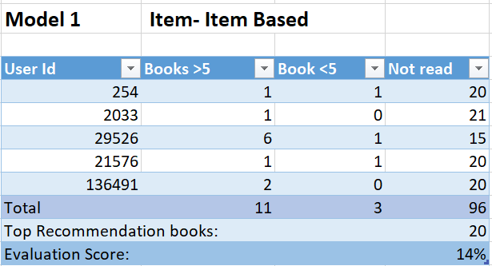
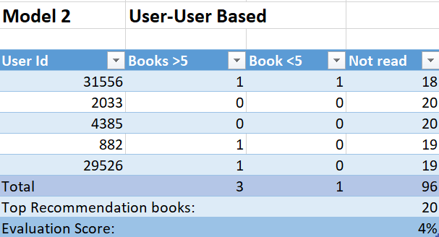
MODEL EVALUATION

Slide 17

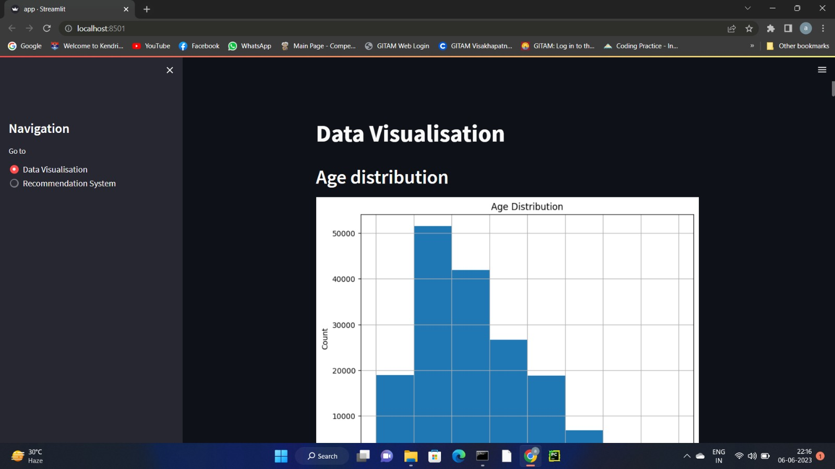
DEPLOYMENT
USING STREAMLIT : Allows to easily create and deploy interactive data science dashboards and machine learning models.

Slide 18
CHALLENGES
Handling of sparsity was a major challenge as well, since the user interactions were not present for the majority of the books.
Understanding the metric for evaluation was a challenge as well.
Since the data consisted of text data, data cleaning was a major challenge in features like Location etc.
Decision making on missing value imputations and outlier treatment was quite challenging as well.

Slide 19
Conclusion
In EDA, the Top-10 most rated books were essentially novels. Books like The Lovely Bone and The Secret Life of Bees were very well perceived.
Majority of the readers were of the age bracket 20–45 and most of them came from the countries namely USA, Canada, UK, Germany and Spain.
If we look at the ratings distribution, most of the books have high ratings with maximum books being rated 8. Ratings below 5 are few in number.
Author with the most books was Agatha Christie, William Shakespeare and Stephen King.
For modelling, it was observed that for model based collaborative filtering was working better with pair-wise method.
Amongst the memory based approach, item-item CF performed better than user-user CF because of lower computation requirements.

Slide 20
Future Scope
Should be given more information regarding the books dataset, namely features like Genre, Description etc.,
We could implement a content-filtering based recommendation system and compare the results with the existing collaborative-filtering based system.
We would like to explore various clustering approaches for clustering the users based on Age, Location etc., and then implement voting algorithms to recommend items to the user depending on the cluster into which it belongs.

Slide 21
THANK YOU

